Slide 1
Project Management:
Process, Technology, and Practice
Ganesh Vaidyanathan
Chapter 2
Process and Methods

Slide 2
Learning objectives
Define project process and how organizations benefit from adopting those processes oriented towards customer satisfaction.
Understand PMBOK® project management processes and how project activities are mapped to these processes for successful project management.
Explain what Continuous Improvement Management (CIM) is and how CIM methodology can be used in projects with examples.
Explain what Six Sigma is and how this process improvement approach is used to find defects and errors of a project with examples.

Slide 3
Learning objectives
Describe the five levels of Capability Maturity Model (CMM) in software projects and understand how organizations can attain the highest software maturity level.
Describe Software Development Life Cycle (SDLC) and the new paradigms in software projects including extreme programming and agile modeling, their inputs and outputs, and how those software development models can be used effectively in software projects.

Slide 4
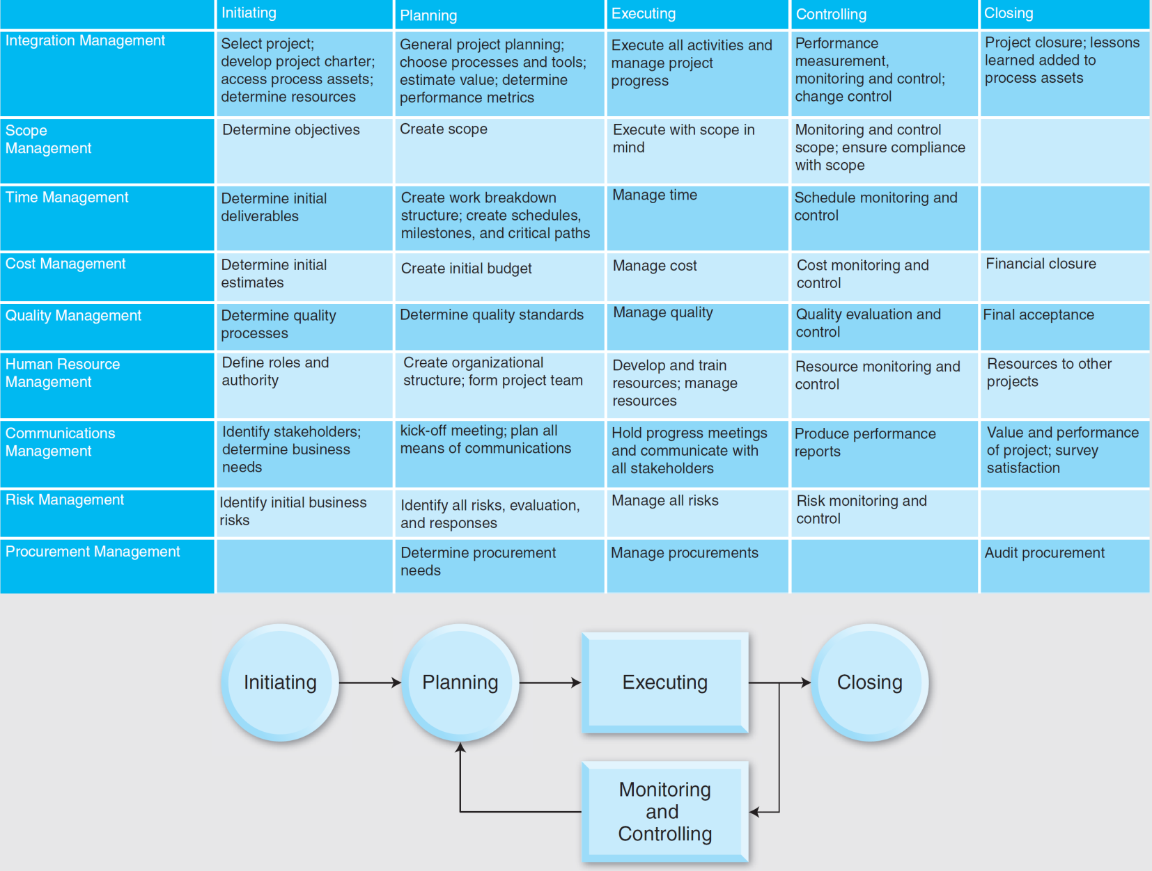

Slide 5

Process
Process is a specific ordering of structured work activities that include a beginning, an end, and clearly defined inputs and outputs.
A business process is a collection of related, structured business activities or tasks in a specific order that produce a specific service or product for a customer.
A project process is a collection of project related structured activities or tasks. In order for a project to be effective, the activities or tasks have to be structured.
A structure provides a standardized way of implementing projects leading to project improvement. The project life span is a structured methodology to implement projects and can be considered an overall project process.

Slide 6
Process and Procedure
Graduation party process
Series of interrelated activities – input to output
Make a list of friends
Invite them for a party
Buy food and beverages
Have fun
Invite friends procedure
Buy invitations for the occasion
Write friends names correctly
Place invitations in envelopes in the right way
Address envelopes with return address
Attach the correct stamp to each envelope
Mail the invitations well in advance

Slide 7
Process Improvement
Is a systematic method to continuously improve how organizations conduct businesses and projects
When employees of an organization get involved in process management, they work together and make the organization better and more profitable by:
satisfying customers
producing products with almost no defects,
eliminating waste, and
implementing successful projects.
Project process improvements contribute to the success of projects.

Slide 8
Process Improvement
Process improvement has worked well for many organizations in their projects, helping facilitate:
better quality,
lower cost,
faster delivery,
better performance, and
increased value.
Continuous Improvement Method (CIM)
Six Sigma process
Capability Maturity Model (CMM) process
Systems Development Life Cycle (SDLC) and other MIS models

Slide 9
Continuous Improvement Management CIM
Is a methodology—a systematic structured process to implement continuous improvement in quality in projects
Involves all employees of an organization for continuous improvements of the organization
All employees need to be knowledgeable and practice this methodology for its success.
Customer-centric, meaning that customers, their requirements, and their satisfaction become the focus a project
Customers defines project requirements, provides budget, determines schedule, determines level of quality, and are one of the stakeholders who demand maximum value from the project.
Scope or requirements of a project needs to be adhered and monitored throughout the life span of the project.

Slide 10
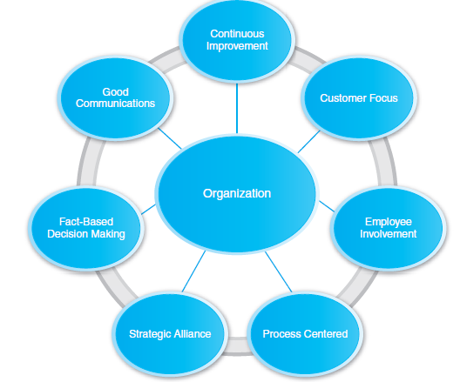
CIM Principles

Slide 11
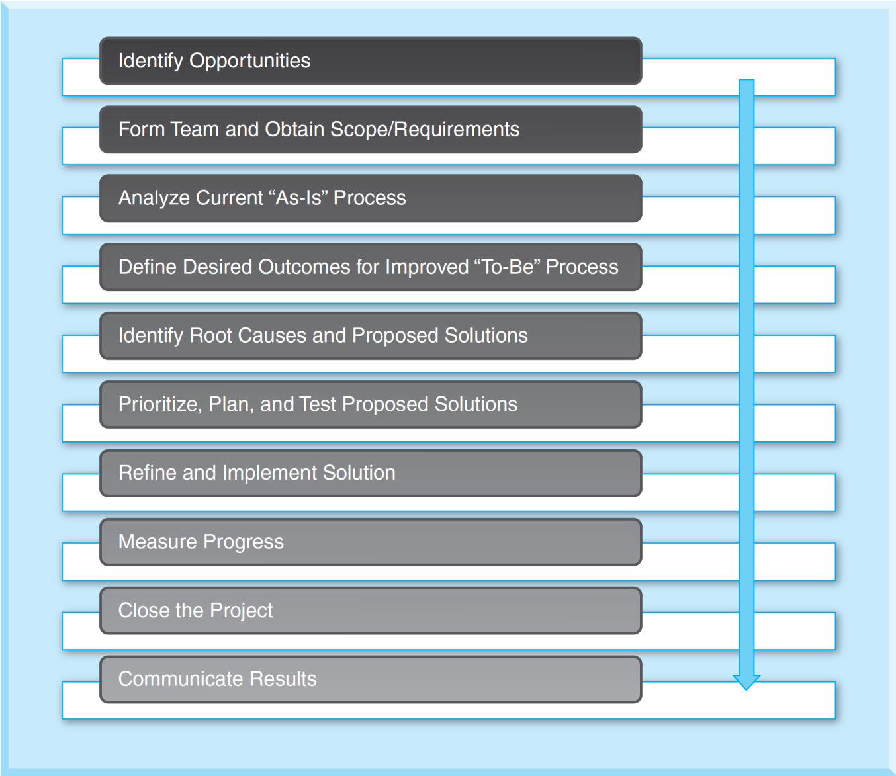
CIM Model

Slide 12
CIM Model – Identify Opportunities
Identification of opportunities is often associated with a specific problem which needs improvement.
These may be existing problems or “to-be” created products or systems or services.
There may be a number of projects that were identified during a period of time.
There may be choices that need to be made.
Choosing projects is accomplished according to organizational criteria.

Slide 13
CIM Model – Identify Opportunities
These criteria may include:
Urgency of a project
Whether the project may be controlled
The difficulty, or complexity of the project
Time period of the project
The amount of resources required for the project.

Slide 14
CIM Model – Form Team and Create Scope
Team formation is critical to the success of a project.
This process helps to clarify roles and responsibilities and designate initial members of a project.
Using team resources, requirements from customer need to be analyzed to establish the scope of a project.
Using the scope of a project, a clear purpose of the project has to be developed.

Slide 15
CIM Model – Form Team and Create Scope
This clear, unambiguous project purpose from project scope will be used later to determine:
Budget
Resources
Schedule
Performance measures
Overall value of a project.

Slide 16
CIM Model – Analyze “as-is” and determine “to-be”
”As-Is” phase
Helps to deduce necessary actions in order to improve the project process
Helps to achieve complete understanding of the existing process so that a project team can have the basis to start the “to-be” part of the project that complies with project scope

Slide 17
CIM Model – Identify root-causes & proposed solutions
Root cause analysis should include:
Technical feasibility, or whether technology exists to implement the proposed system
Economic feasibility to establish the cost-effectiveness of the proposed system
Legal feasibility that determines legal requirements
Operational feasibility, or whether current work practices and procedures are adequate to support the new system
Social feasibility to reflect on organizational changes that may affect users of the system, and
Project feasibility to determine scope, schedule, budget, performance, and value.

Slide 18
CIM Model – Implementation, Progress, Closure
Priorities and planning of a project can be achieved to implement these solutions.
Progress, performance, and value must be measured, monitored, and controlled at every point of a project.
Budget and schedule has to be monitored and controlled at every point of a project.
Project has to be monitored and controlled to adhere to project scope and project requirements at every point of the on-going project.
Results of projects need to be communicated to all stakeholders on an ongoing basis and should be used for lessons learned from the project.

Slide 19
Six Sigma
Six Sigma is a process improvement approach that is used to find and eliminate errors and defects, reduce cycle times, reduce cost, improve productivity, and meet customer expectations.
Six Sigma is oriented toward the solution of problems at root cause and prevention of their recurrence. Project management typically is to control potential causes of failure. Since we have recognized that project management is a process, Six Sigma is a potential candidate applicable to project process improvement.
Six Sigma provides a structured data-driven methodology with tools and techniques that help organizations measure their performance.

Slide 20
Six Sigma
Using Six Sigma, organizations can measure the baseline performance of their project, determine the root causes of variations in processes in those projects, and improve their processes to meet and exceed desired performance levels. Six sigma can be used in projects to improve quality performance of projects.
Six Sigma is a metric-driven methodology.

Slide 21
Six Sigma
DMAIC Process
Define
Measure
Analyze
Improvement
Control
DMADV Process
Define
Measure
Analyze
Design
Verify
DMAIC is used for projects aimed at improving an existing business process in a project.
DMADV, another methodology, is used for projects aimed at creating new product or process designs.

Slide 22
DMAIC
Define
This phase is about defining the problem statement of the project.
A problem statement is a clear description of project issues that have to be addressed by a project team in order to implement a project effectively and efficiently.
This phase is very much like the project initiation phase that we will discuss in detail in later chapters.

Slide 23
DMAIC
Measure
This phase focuses on the measurement of internal process that impacts factors that are critical to quality.
All important factors that can be controlled or changed to improve factors that are critical to quality have to be understood clearly.
For example, in the restaurant delivery system that we discussed before, delivery of subs to the customers may be a function of many factors that are critical to quality.
Once the relationships are established, data and observations can be collected.

Slide 24
DMAIC
Analyze
This phase focuses on why and how defects and errors occur.
Processes are analyzed to determine the root causes of poor performance and whether the process can be improved or should be redesigned.
The collected data and observations are used to verify relationships between variables.
This root cause analysis gives a stable and reasonable approach to find which factors critical to quality need to be improved.

Slide 25
DMAIC
Improve
This phase is devoted to idea generation for improvement of factors that are critical to quality.
Improving processes based on measurements and analysis can ensure that defects are lowered and processes are streamlined.
Project management techniques are used to plan and implement these ideas.
We will discuss project management techniques for planning and implementation in later chapters.

Slide 26
DMAIC
Control
Control ensures that variances that display in the project process are corrected.
Controls can be in the form of pilot-runs to determine if the processes are within specifications and then transitioned into project implementation.
Continued measurement and analysis must ensue to keep processes on track and free of defects to ensure the targeted sigma level.
The difference in this type of control to project management control is that in this method Statistical Process Control (SPC) technique is employed to monitor the performance of key measures.

Slide 27
Software Process
Software Process
A set of activities, methods, practices, and transformations that people use to develop and maintain software and its associated products that include project plans, design documents, code, test cases, and user manuals
Software Process Maturity
A potential for growth in capability and indicates both the richness of an organization's software process and the consistency with which it is applied in projects throughout the organization

Slide 28
CMM and CMMI
CMM - Capability Maturity Model
A model for software implementation used by many organizations to identify best practices that are useful in increasing the maturity of their processes
CMMI - Capability Maturity Model Integration
Successor of CMM
CMM and CMMI bring in an overall organized strategy to improve software process and efforts.
They show an evolutionary path to achieve project results from process improvement efforts.

Slide 29
CMM and CMMI
They provide a roadmap for continuous process improvement .
They act as guides to the advancement and identify deficiencies in an organization.
They are not intended to provide a quick fix for projects in trouble.

Slide 30
The Benefits of CMM and CMMI
Provide guidance on how to gain control of their processes to develop and maintain software
Allow organizations to strategize how to evolve toward a culture of software engineering and management excellence
Guide software organizations in selecting process improvement strategies by determining current process maturity and identifying the few issues most critical to software quality and process improvement
Allow organizations to focus on a limited set of activities and work aggressively to achieve them so that organization-wide software processes are enabled to be continuous and lasting gains in software process capability

Slide 31
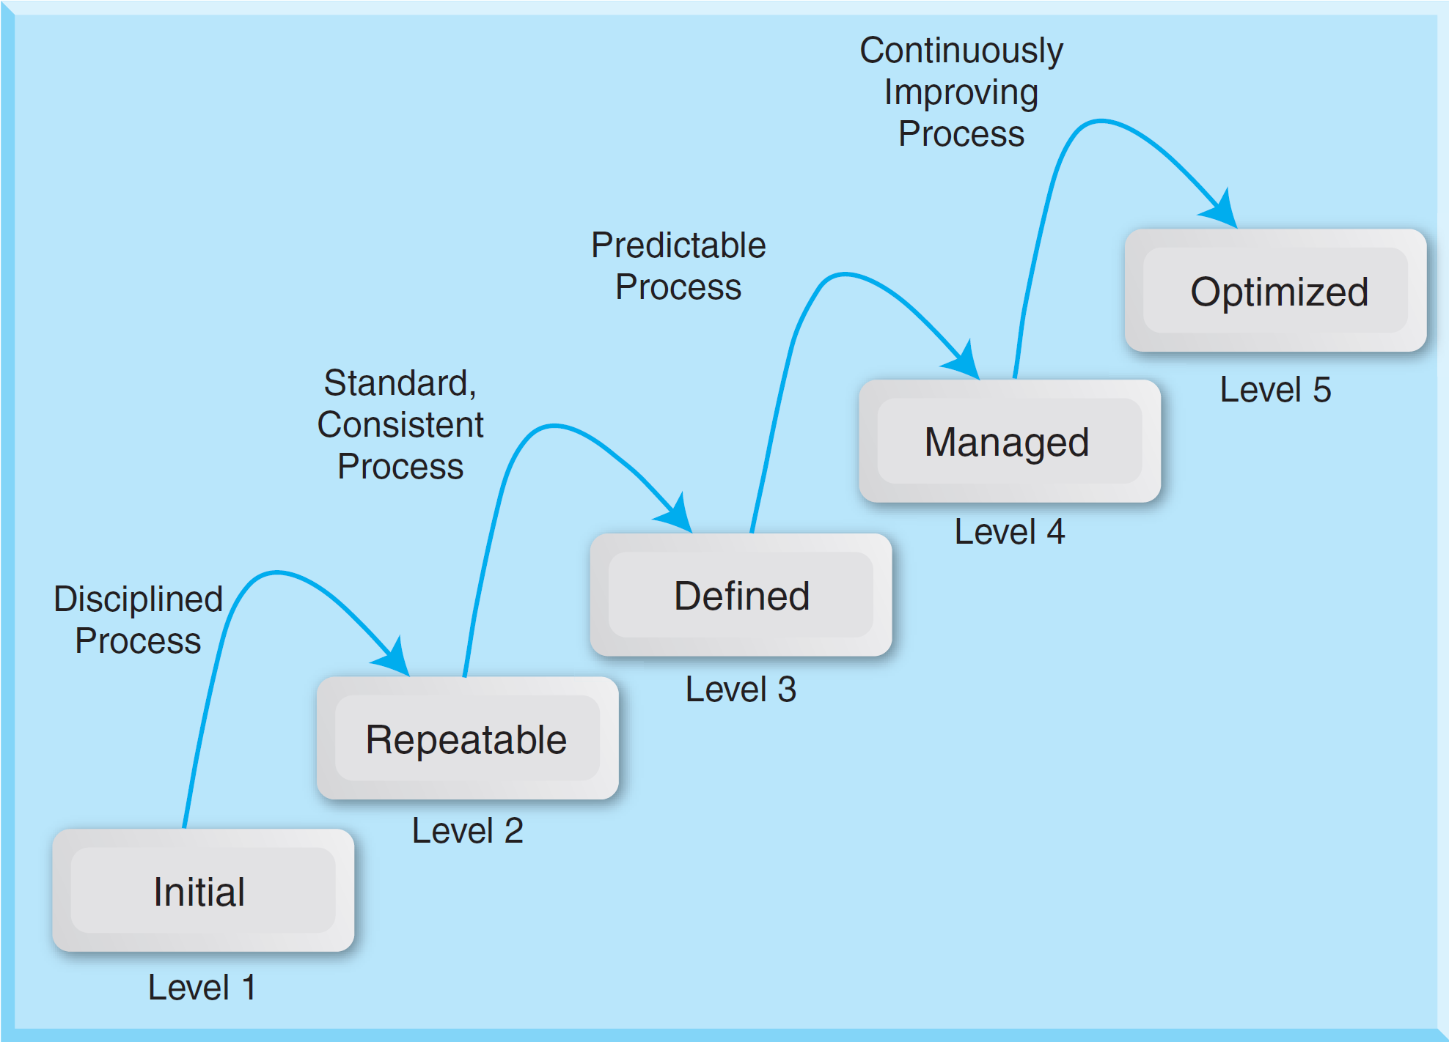
CMM

Slide 32
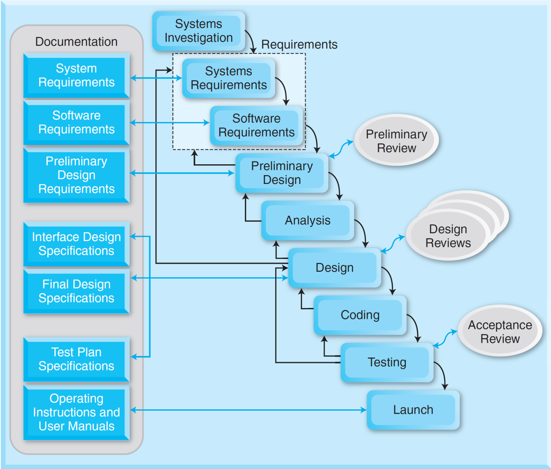
SDLC

Slide 33
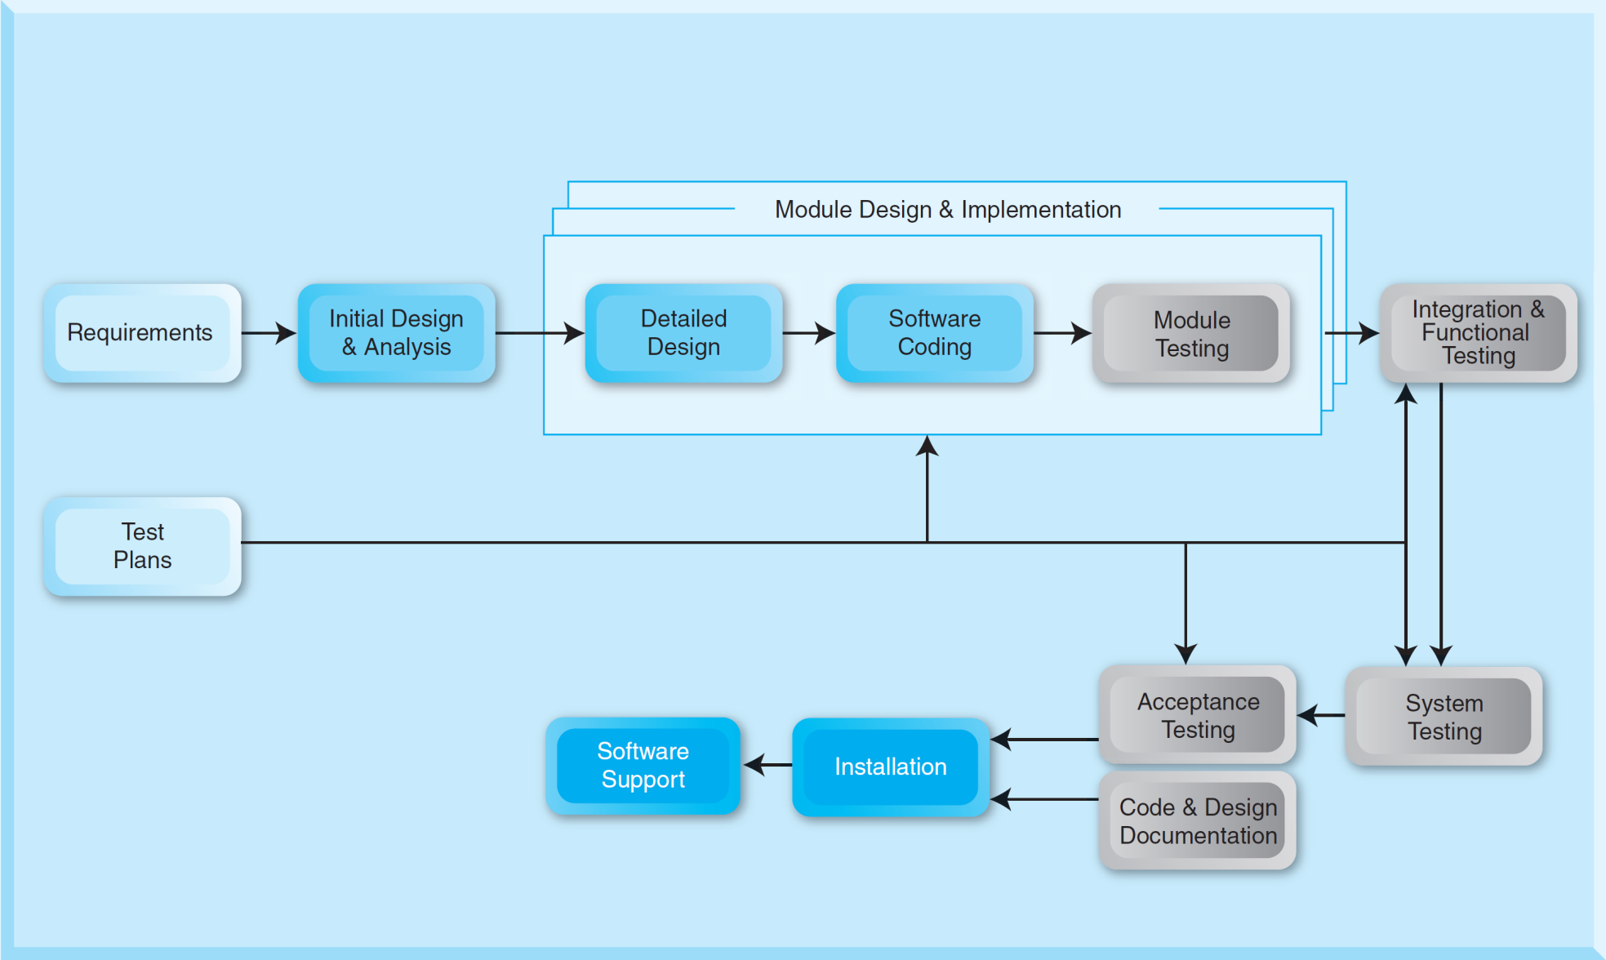
Iterative SDLC

Slide 34
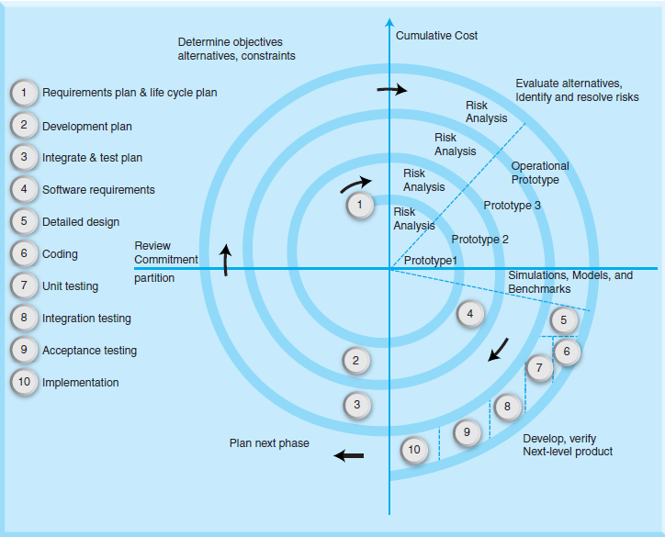
Spiral

Slide 35
Unified Process
The Unified Process (UP) is a software engineering process.
It is used to develop object-oriented software.
The Unified Modeling Language (UML) is a core notation incorporated within UP.
UML is designed to clearly communicate the most essential elements of object-oriented software development projects including requirements, architectures, and design.
UML is a graphical language for visualizing, specifying, constructing, and documenting object-oriented software.

Slide 36
Unified Process and Use Case Analysis
UP is an iterative process and defines four phases including:
Inception
Acquire Customer requirements and Planning
Elaboration
Use Case Diagrams
Construction
Development
Time-boxed iterations (e.g. 1 week)
Transition
Beta testing and Final testing
Installation, training, and support
Reconcile
POS
Clerk
Customer
Transactions
Approve
Approve
Manage
Resources
Store
Manager
Order
Inventory

Slide 37
Unified Process
Example of UP
Rational Unified Process-System Engineering (RUP-SE)
Develop software iteratively
Manage requirements
Use component-based architectures
Visually model software
Verify software quality
Control changes to software

Slide 38
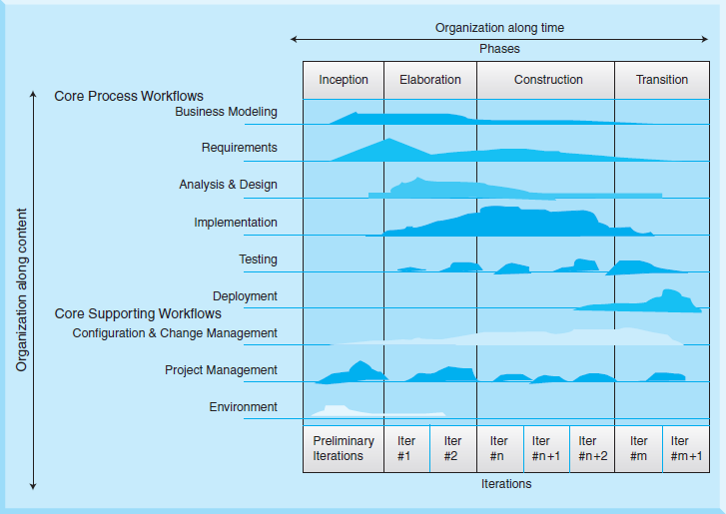
Unified Process
Horizontal axis represents time, shows the dynamic aspect of the process as it is enacted; expressed in terms of cycles, phases, iterations, and milestones
Vertical axis represents the static aspect of the process, i.e., how it is described in terms of activities, artifacts, workers

Slide 39
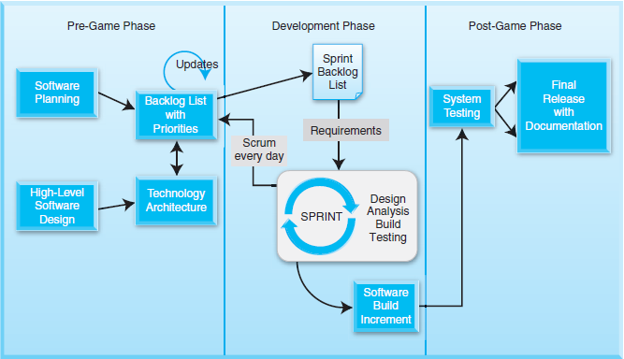
Scrum

Slide 40
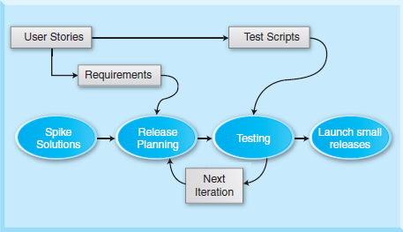
Extreme Programming (XP)

Slide 41
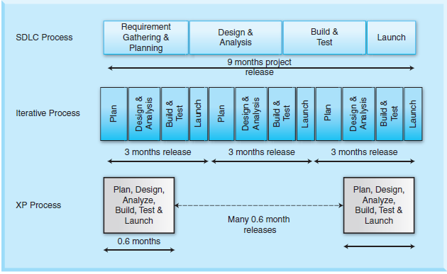
Extreme Programming (XP)

Slide 42
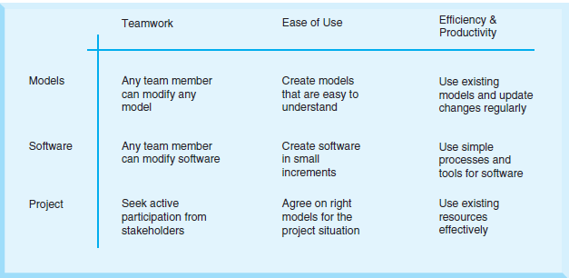
Agile Modeling (AM)

Slide 43
Summary
A project process is a collection of related structured activities or tasks of a project.
Every project is aligned to the strategy of an organization and is always a part of a continuous improvement process.
Process improvement is a systematic method to continuously improving how organizations conduct businesses and projects.
When employees of an organization get involved in process management, they work together and contribute to the success of projects.

Slide 44
